Slide 1





Toward a More Sustainable Maryland
PRESTO Model Results
July 11th, 2017

Slide 2

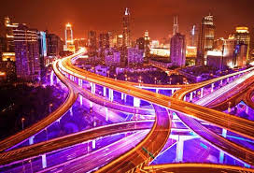
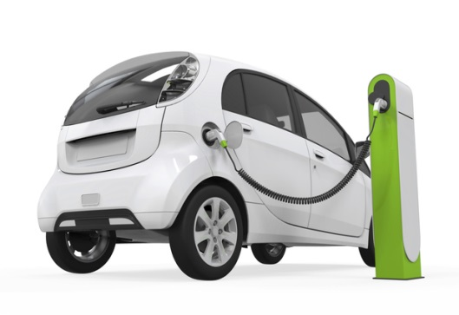
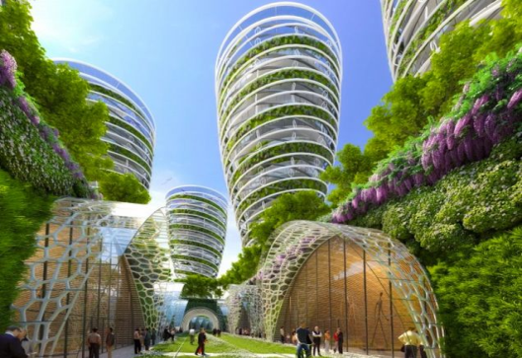
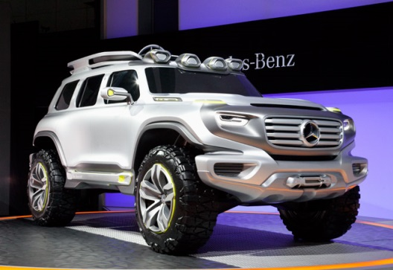
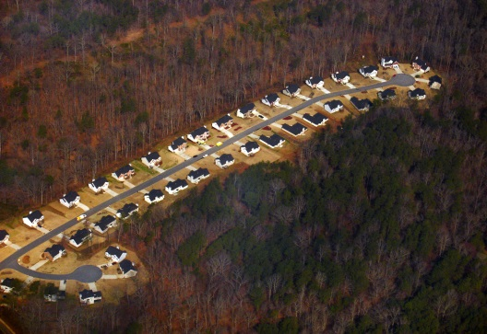
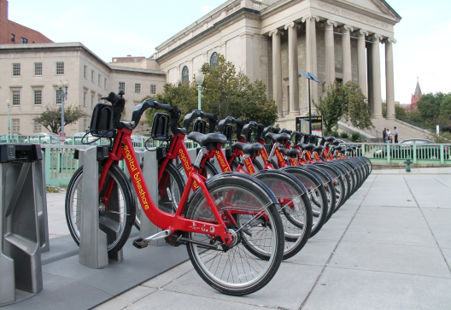
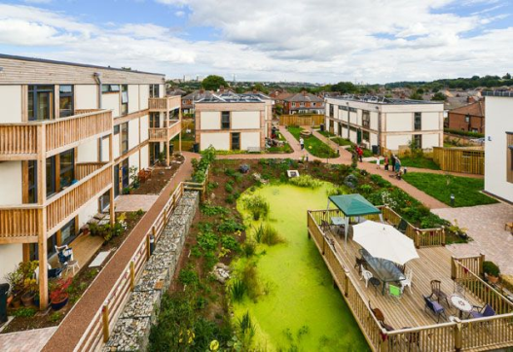
Revenge of the Nerds
Blue Planet
Ashes and Diamonds
Last Call at the Oasis

Slide 3





Selected Inputs for Alternative Scenarios
Vehicle Characteristics
Network Characteristics
Economic Projections
Development Capacity
Climate Policy

Slide 4
Land Use

Slide 5
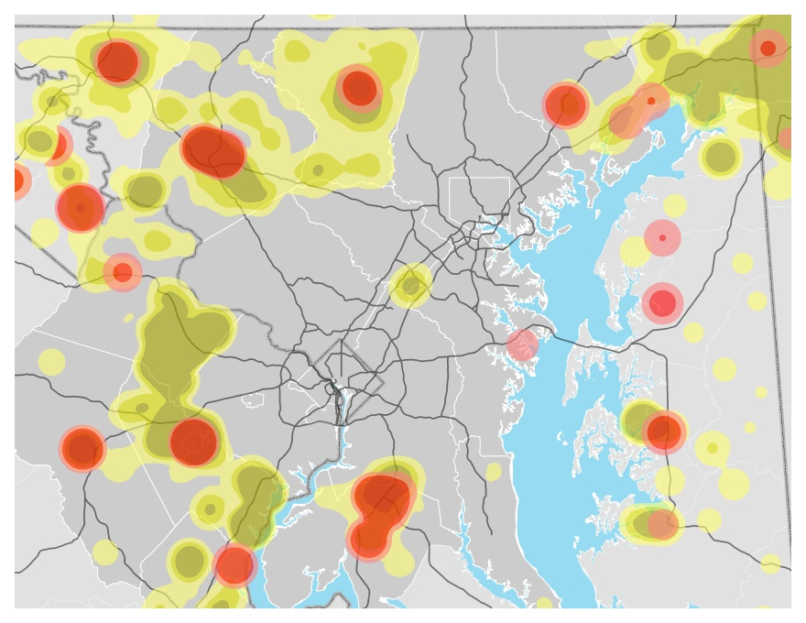
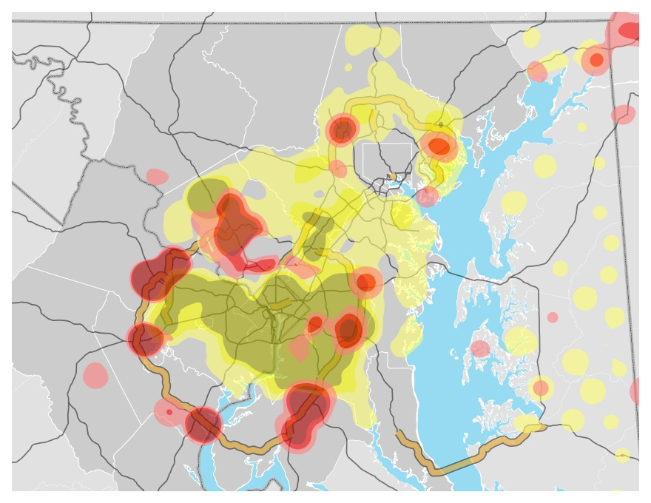

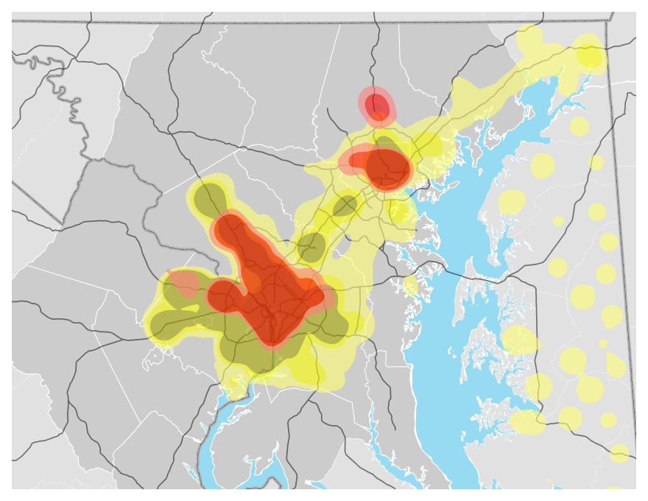
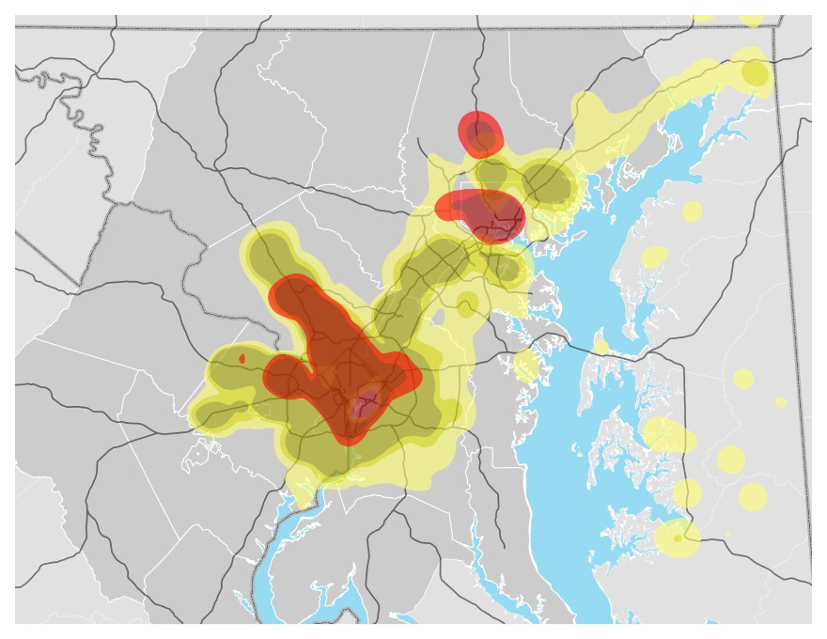


Residential Patterns Reflects Employment location, Travel Costs, and New Residential Capacity
Revenge of the Nerds
Ashes and Diamonds
Blue Planet
Last Call at the Oasis

Slide 6
Households Relative to Base Scenario
Inner Suburbs Growth When Capacity is Provided, Exurbs Grow with AVs
Entire Baltimore Washington Region

Slide 7
Autonomous Vehicles Push Growth Outside the Baltimore Washington Region

Slide 8
Revenge of the Nerds
Autonomous vehicle technology encourages households to move further out. Growth in exurban areas around medium and small sized towns increases.
Additional development capacity in core areas and inner suburbs absorbs much of the additional household growth, but most areas throughout the region grow.
Blue Planet
Ashes and Diamonds
With more development capacity in all areas, many households favor newly opened up areas in already attractive inner jurisdictions, particular on new highways.
Last Call at the Oasis
Severe restrictions on development capacity outside of the priority funding and capacity for growth near rail pushes more growth toward the inner suburbs, but some core areas do not grow.

Slide 9
Transportation

Slide 10
Autonomous Vehicles Significantly Increase Miles and Hours on Road

Slide 11
Fuel Prices Have Greatest Influence on Transit Ridership

Slide 12
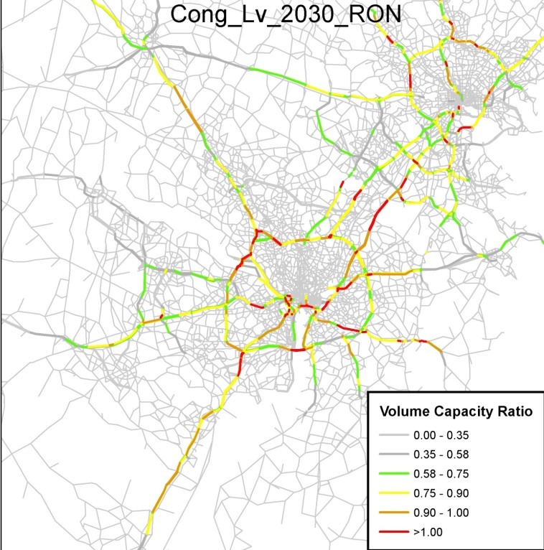
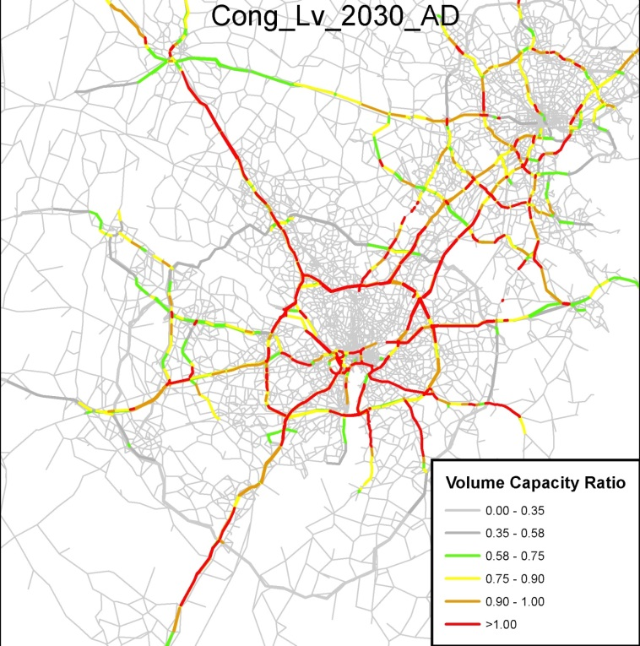
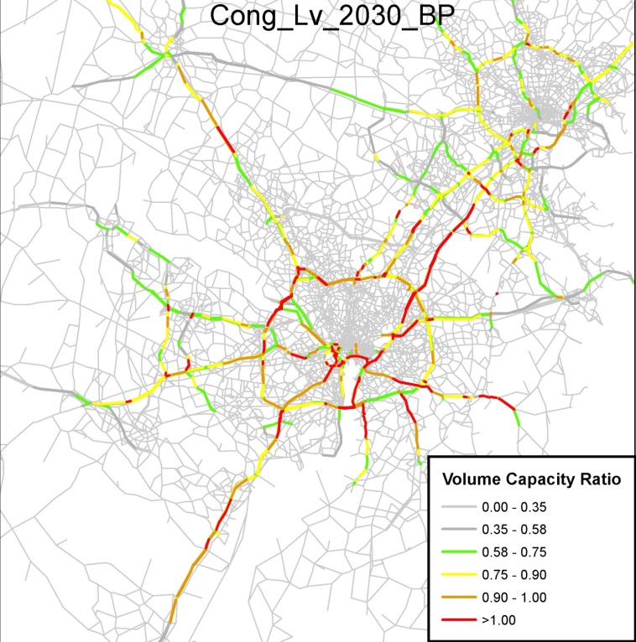
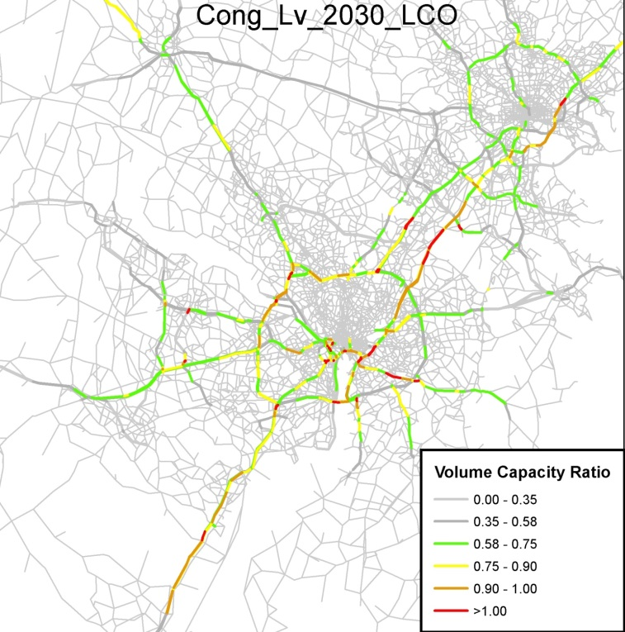
Highway Congestion Levels
Highway Congestion Levels
Revenge of the Nerds
Ashes and Diamonds
Highway Congestion Levels
Highway Congestion Levels
Blue Planet
Last Call at the Oasis

Slide 13
Revenge of the Nerds
Autonomous vehicle technology dramatically increase the distance people drive and time spent in the car.
Increased gas prices and new transit encourage mode shift but cars remain dominate and congestion worsens.
Blue Planet
Ashes and Diamonds
Low gas prices keep encourage more congestion, but households willing to pay for new toll roads can often avoid traffic.
Last Call at the Oasis
Extremely high gas prices double transit ridership relative to baseline and clear up much core congestion.

Slide 14
Housing

Slide 15
Multifamily and Town Homes Exceed Detached Housing in All Scenarios

Slide 16



Because of Existing Stock, Overall Housing Mix Changes Little

Slide 17
Housing Prices Driven by Local Capacity to Absorb New Units, Especially In Inner Suburbs

Slide 18
Lower Income Households Burdened With Greatest Increase in Housing Cost

Slide 19
Core Area Become Significantly Wealthier, Though Increasing Core Development Capacity Decrease Wealth Increase
Income Groups in Washington DC
Income Groups in Baltimore City

Slide 20
With more development further out in the region, single family housing remains plurality of new development. Failure to open on capacity in the core increases prices and encourages high income growth in core.
Revenge of the Nerds
Blue Planet
New capacity in core and inner suburbs dampen price increases in spite of fast growth. Multi-family housing plays a significant role in new development.
Ashes and Diamonds
Increases in development capacity everywhere and slow growth dampens price increases but much of the new capacity in far out areas has little impact. Housing units similar to in the baseline.
Last Call at the Oasis
Increased capacity near rail and decreased capacity in rural areas ensures that multi-family units are the majority of new units. Slow growth and additional core/inner capacity dampen price increases and high income household growth in core.

Slide 21
Emissions

Slide 22
New Technology and Higher Fuel Prices Both Play and Role in Decreasing Building Emissions

Slide 23
Autonomous Vehicles Increase Emissions,
Electric Vehicles Decrease Emissions

Slide 24
Revenge of the Nerds
Additional driving in autonomous vehicles dramatically increases greenhouse has emissions from vehicles. Electric vehicles, adopted slowly, cannot mitigate the impact.
Fast adoption of electric vehicle and green building technology generate deep reductions in greenhouse gas use.
Blue Planet
Ashes and Diamonds
Low energy prices encourage more energy use per capita but slow growth keeps overall emissions similar to the baseline.
Last Call at the Oasis
GHG cuts from vehicles lags behind blue planet. With residential buildings, higher gas prices encourage more frequent retrofitting and higher standards for new development.

Slide 25
Land Cover

Slide 26
In All Scenarios Forest and Farms Continue Steady Decline

Slide 27
Land Protection and Growth Rate are Primary Determinant of Land Cover Change

Slide 28
Forests Are Most Vulnerable In Suburban Washington

Slide 29
Threatened Farmland More Widespread

Slide 30
Statewide Green Infrastructure Impacts Similar to Land Change Impacts

Slide 31
Revenge of the Nerds
High economic growth rate and no additional land protections increase the rate of land cover change and impacts on environmental areas. Farms are particularly impacted by far out growth.
The overall impacts of fast economic growth are somewhat mitigated by additional protected land. Overall Impacts similar to baseline.
Blue Planet
Ashes and Diamonds
Though protections are fewer, the overall impacts on land cover change are similar to baseline and blue planet. Slow growth prevents further land cover change.
Last Call at the Oasis
The combinations of new protections on environmentally sensitive land and slow economic growth reduce land cover and environmental area impacts by around 20%.

Slide 32
Water Pollution

Slide 33
Farmland Conversion In Eastern Shore Decreases Nitrogen Loads

Slide 34
Land Conservation Very Impactful On Phosphorus Loads

Slide 35
Forest Conservation Also Prevents Sediment Loads

Slide 36
Revenge of the Nerds
Phosphorus loads increase more than any other scenario. Nitrogen load increase is minimized by conversion of polluting farmland.
Forest land conversion causes blue planet to have the highest nitrogen loading.
Blue Planet
Ashes and Diamonds
Ashes and diamonds has lowest nitrogen loads due to low growth that reduces land conversion.
Last Call at the Oasis
Generally the lowest nutrient loading with the exception of nitrogen.

Slide 37
Opportunity

Slide 38
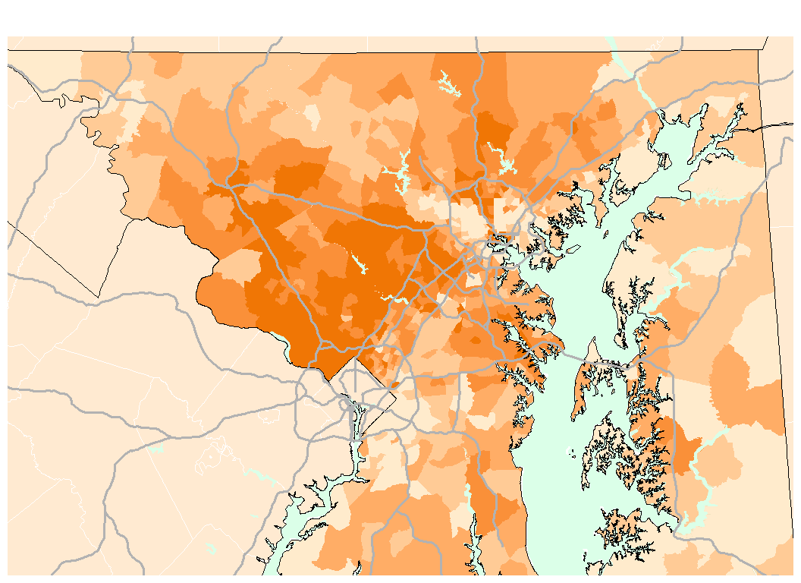
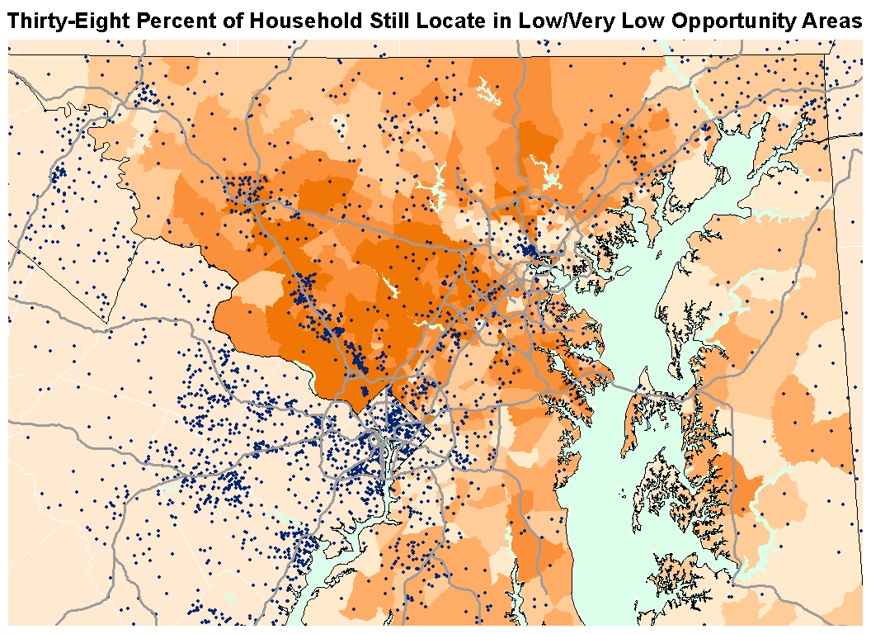

Baseline Opportunity Map
Source: NCSG Opp. Map
Notes:
37 percent of new households will live in areas of low or very low opportunity. This is somewhat less than the 40 percent of current households that live in such areas.
On the other end of the spectrum, 38 percent of new households will live in areas of high or very high opportunity, close to the 40 percent of households that do so now.

Slide 39
More Households Live in Low Opportunity Areas

Slide 40
Compiled Results
Land Use
Transportation
Carbon
Air Pollution
Land Cover
Eco. Areas
Nutrient Loading

